Slide 1
Goal Tracker
Java Jamboree

Slide 2
Purpose
The purpose of this standalone application is to help you move towards a goal (career, educational, personal, or otherwise) in order to keep you from stagnating and becoming a boring lump. It helps you prioritize important activities while avoiding unimportant time-wasting activities.

Slide 3
Important user stories
1) As a person with short term and long term goals
In order to manage and achieve both goals without compromising one for other
I want to keep track of To-do list, time to time.
2) As a person with multiple tasks
In order to view all my tasks in a larger time-frame
I want to view my tasks in a month or week view.

Slide 4
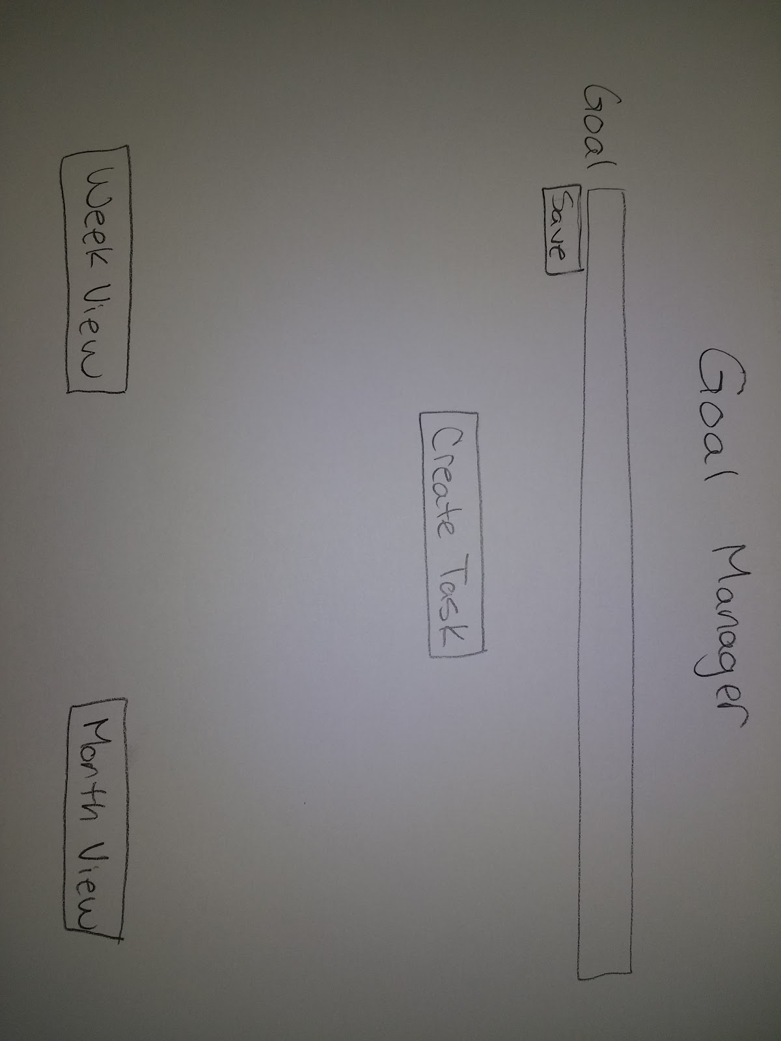
Screen mockups – Main view

Slide 5
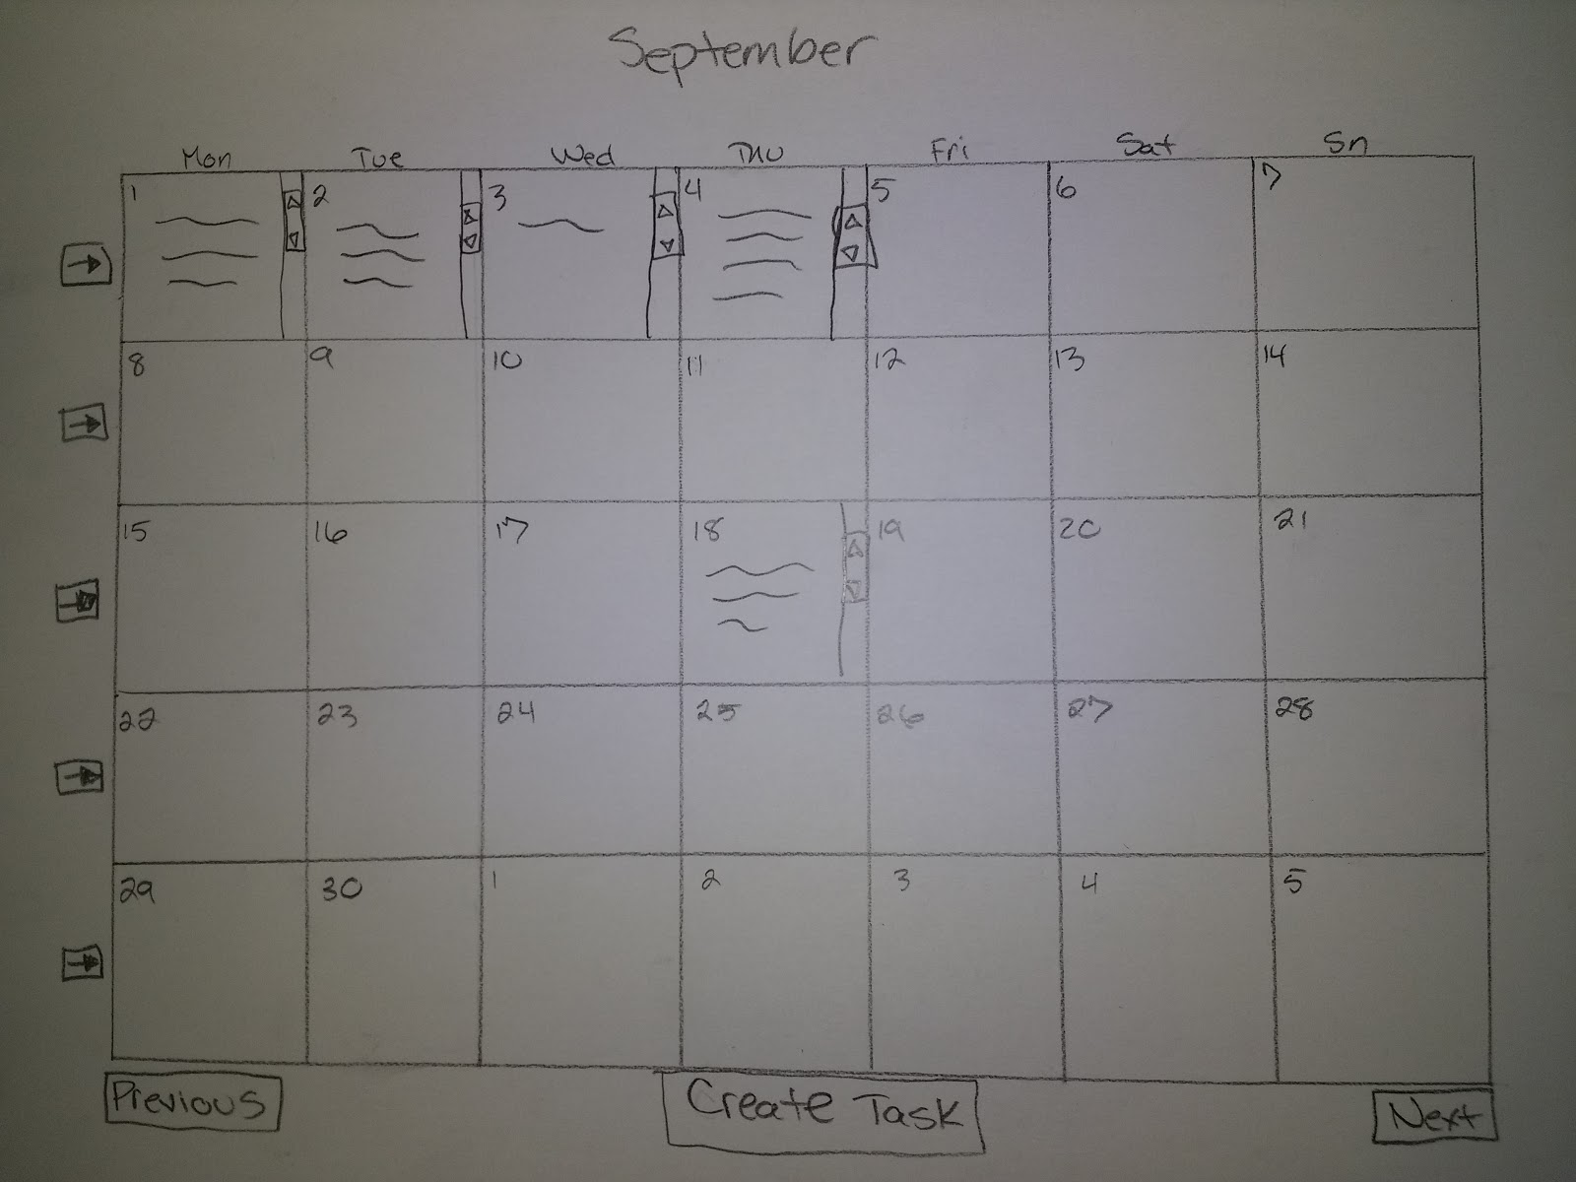
Screen mockups – Month view

Slide 6
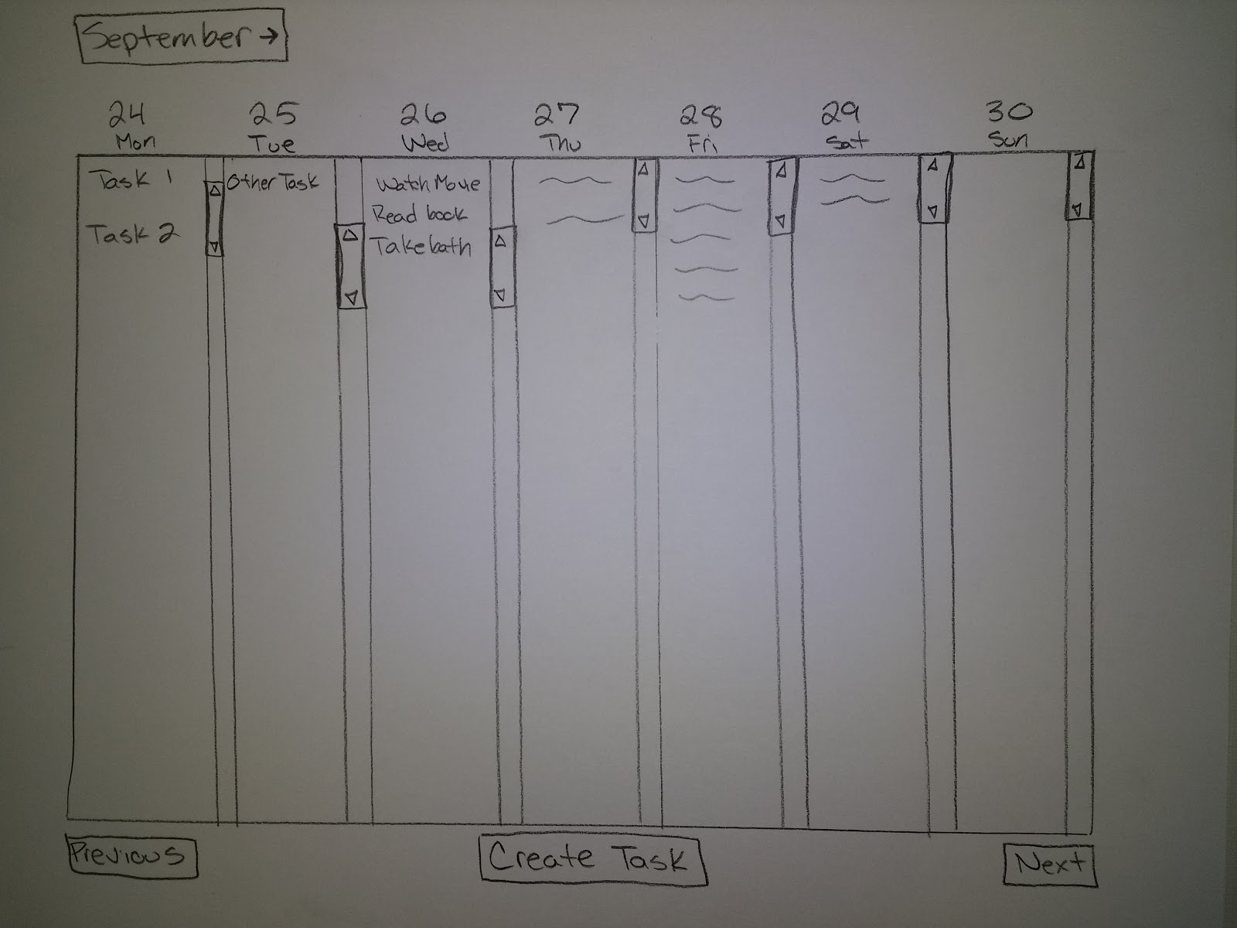
Screen mockups – Week view

Slide 7
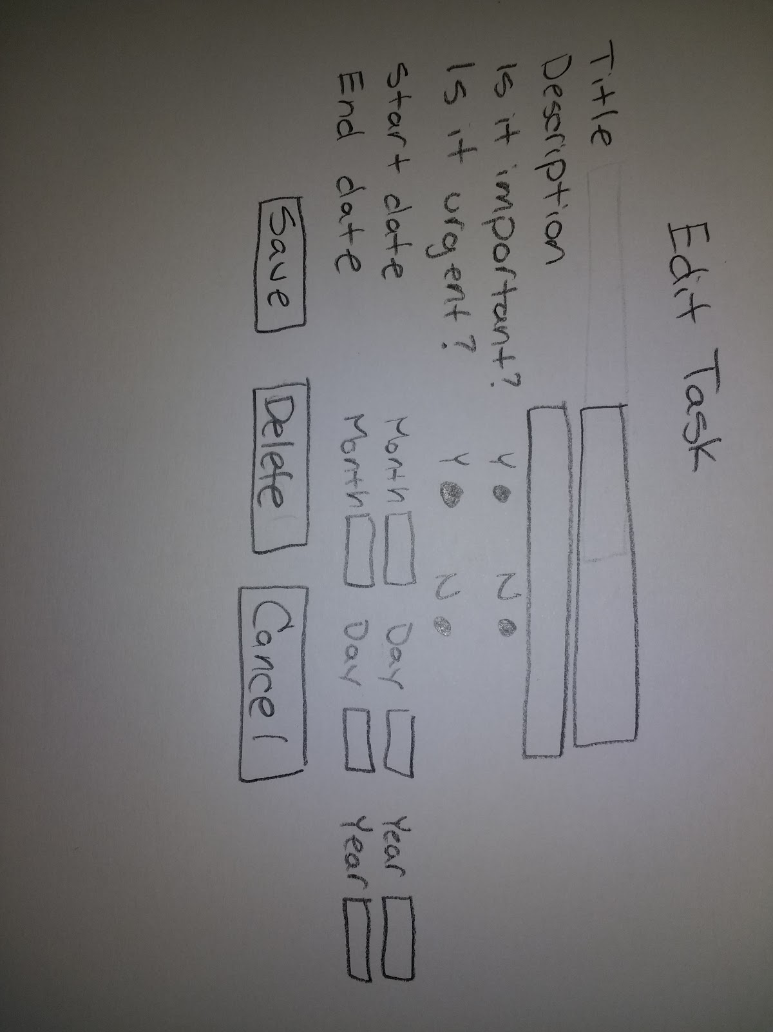
Screen mockups – Task view

Slide 8
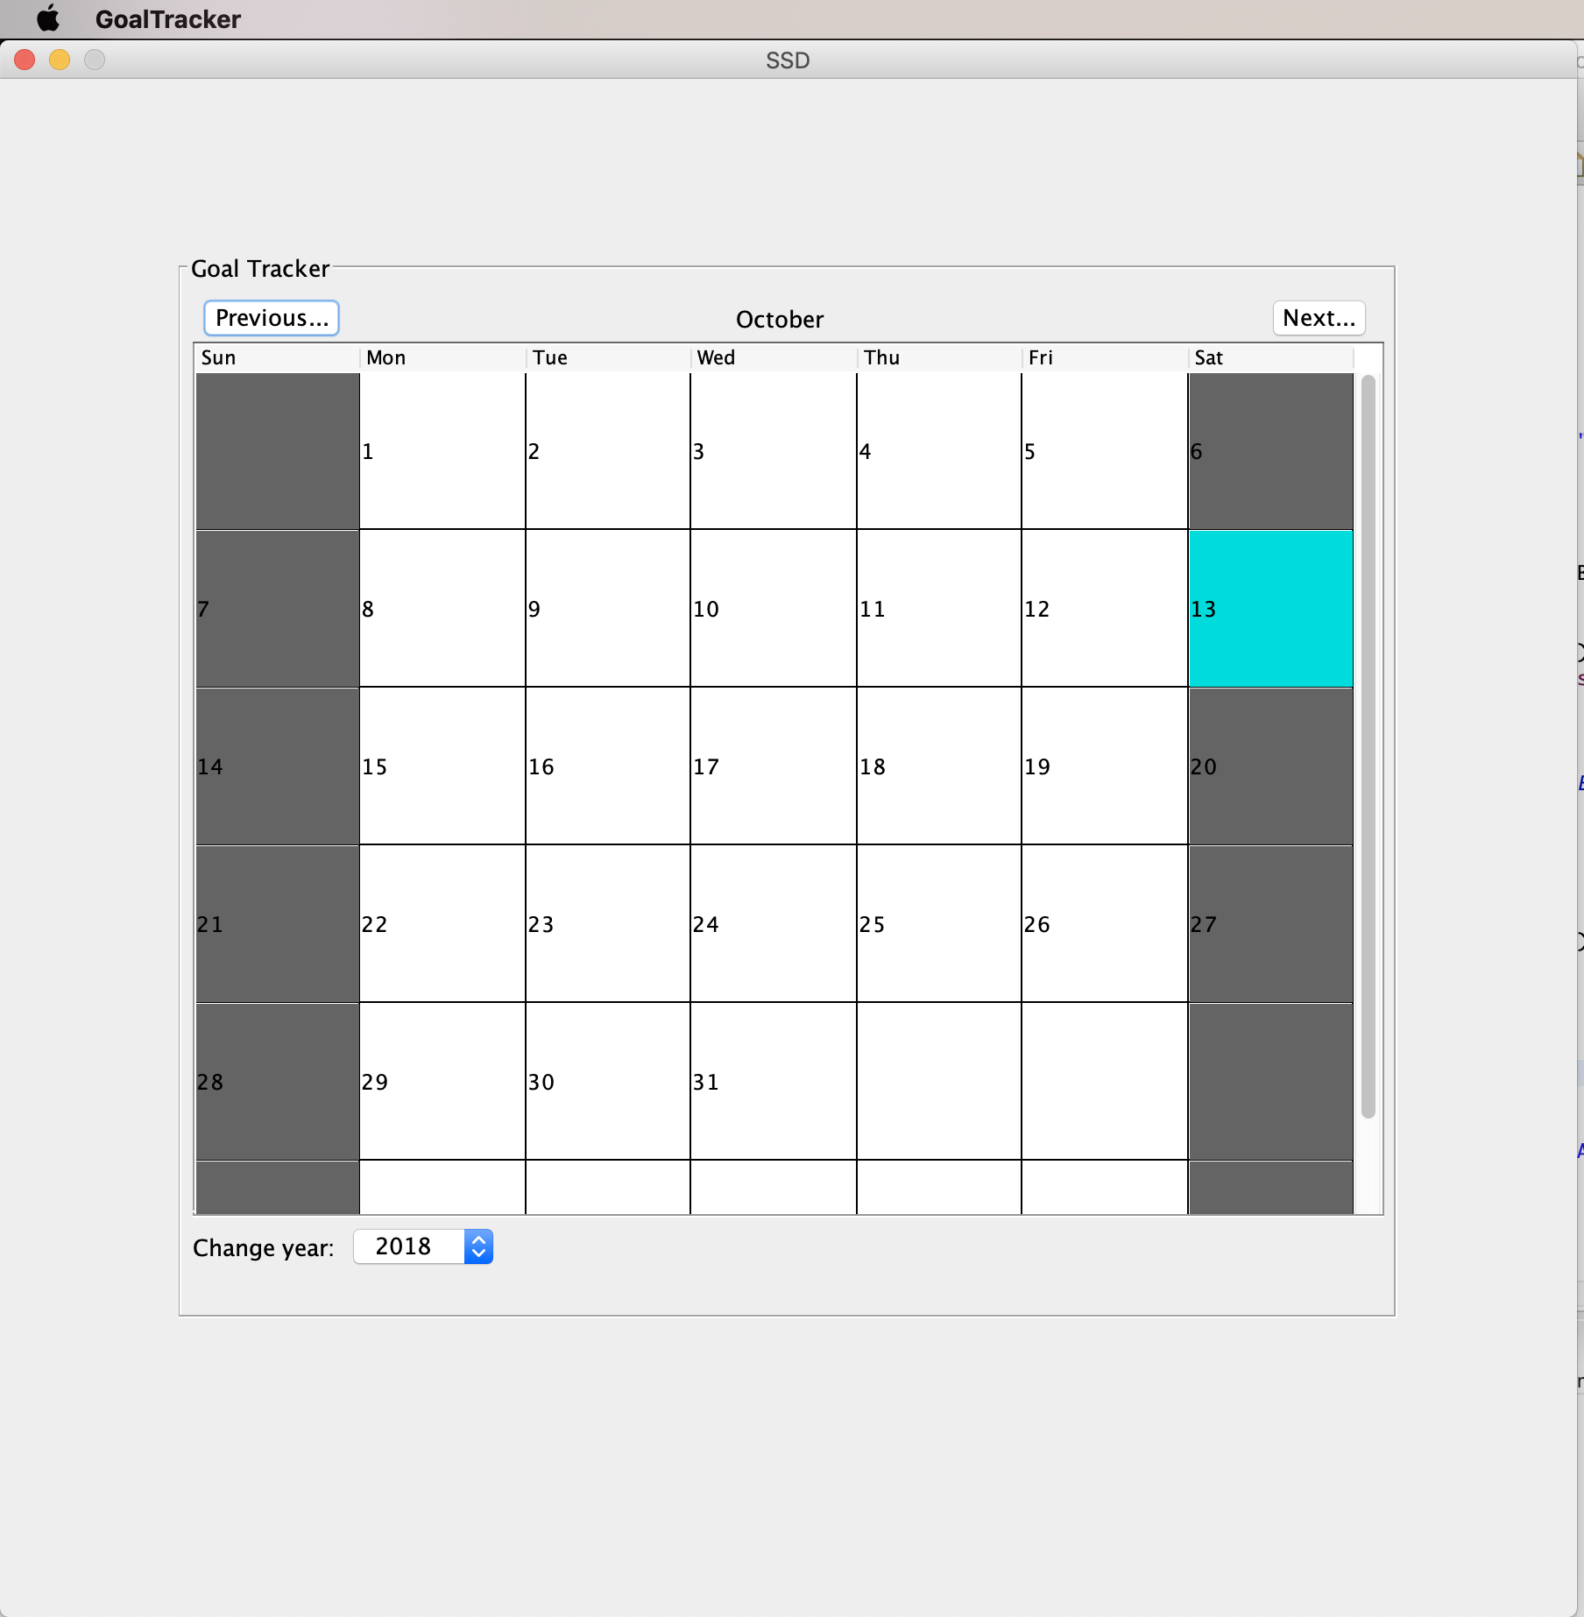
Implemented functionality – Month view

Slide 9
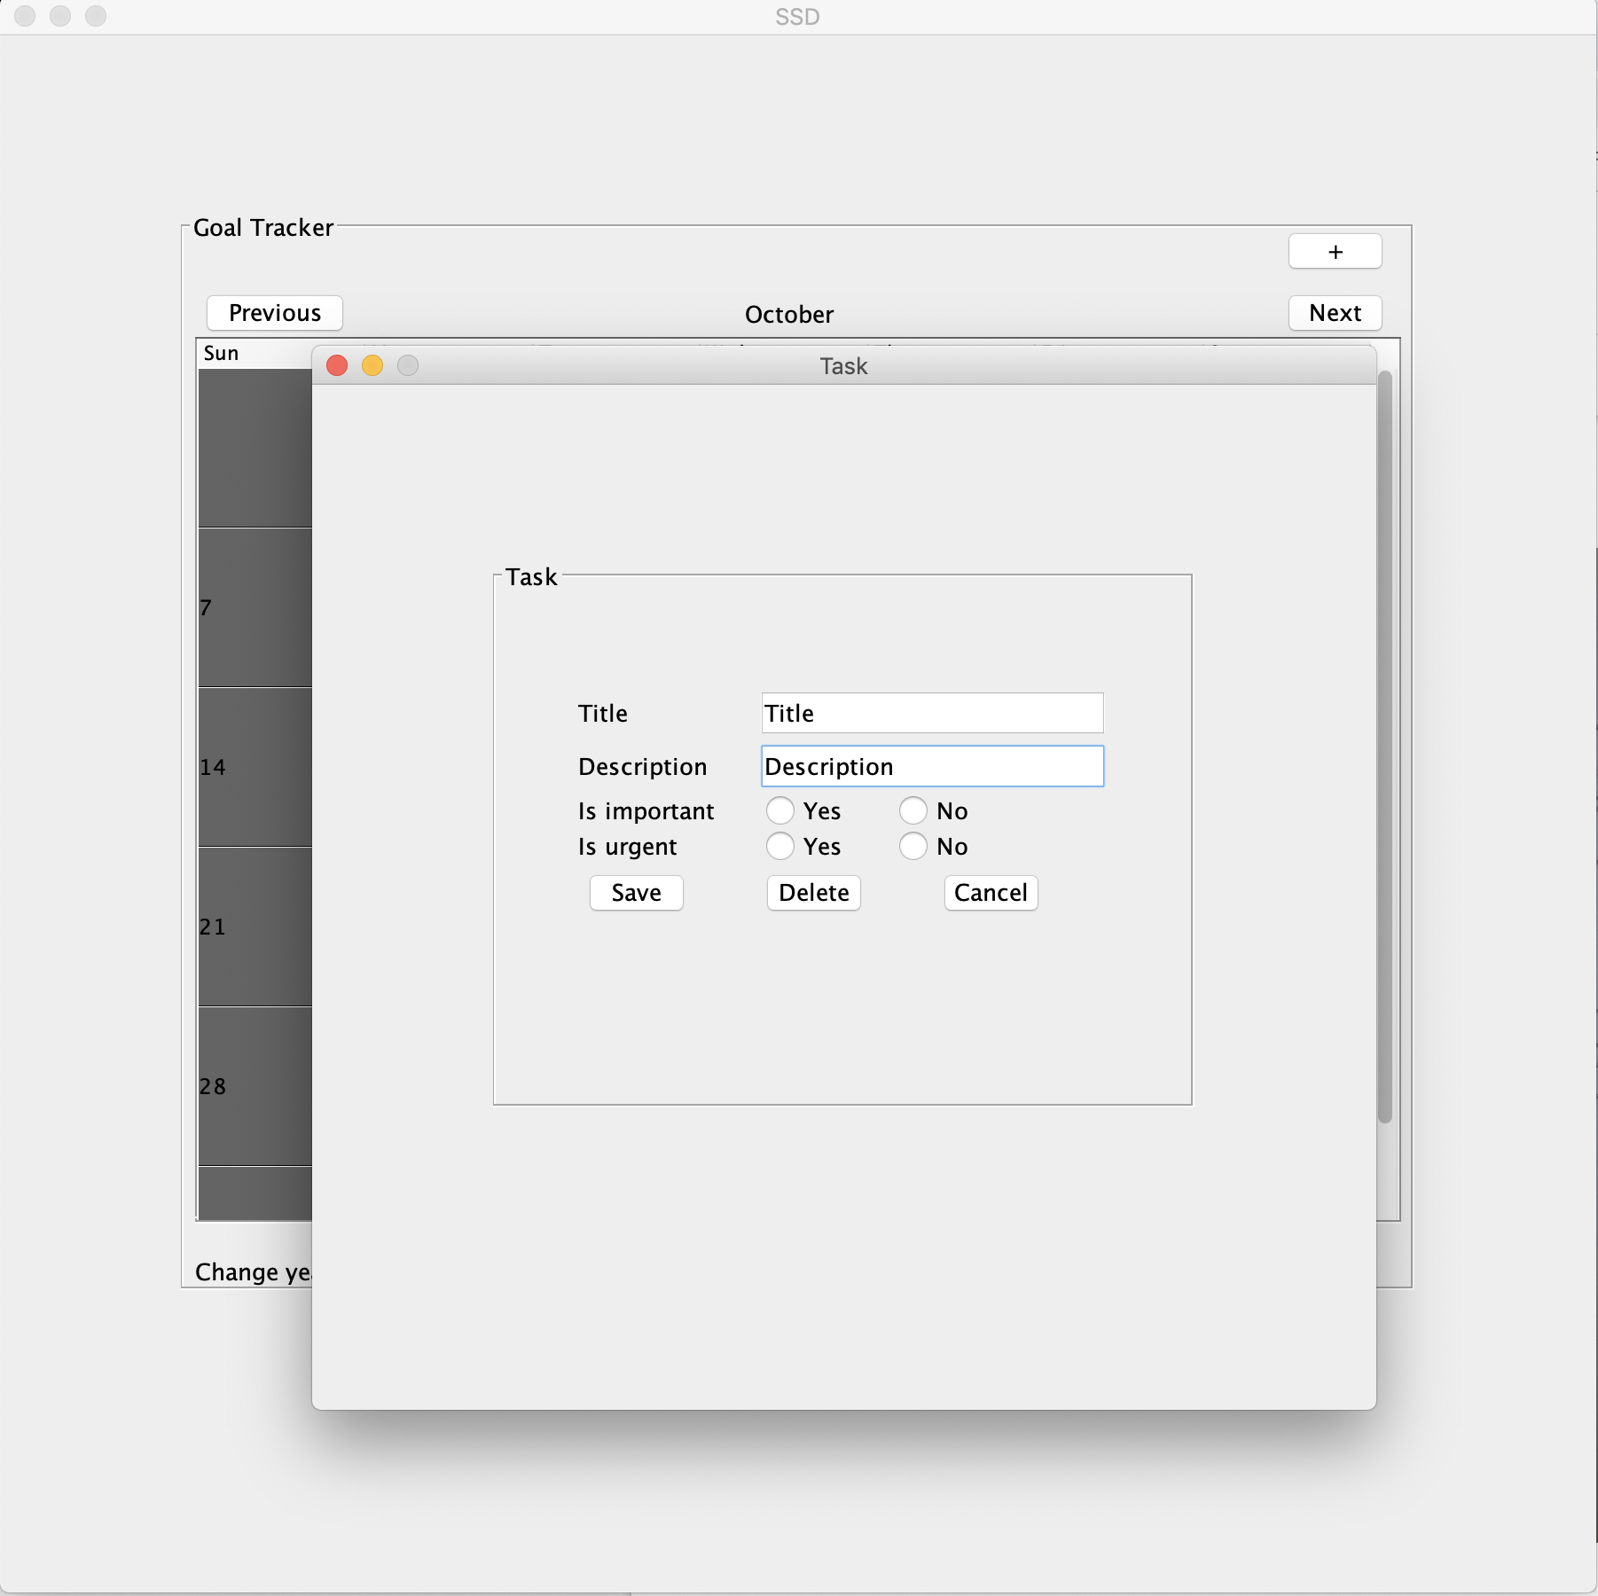
Implemented functionality – Task view

Slide 10

Thank You..

